Slide 1
Prototype #1 Presentation
Team Oceanus

Slide 2
Thermals, Mechanisms, Structures (TMS)

Slide 3
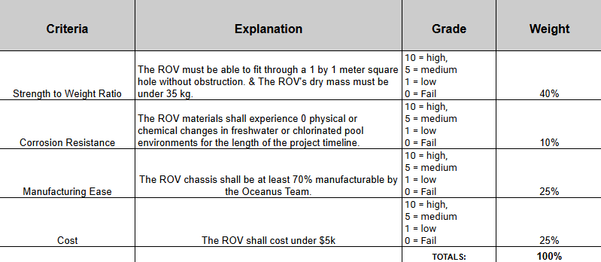
Material Justification

Slide 4
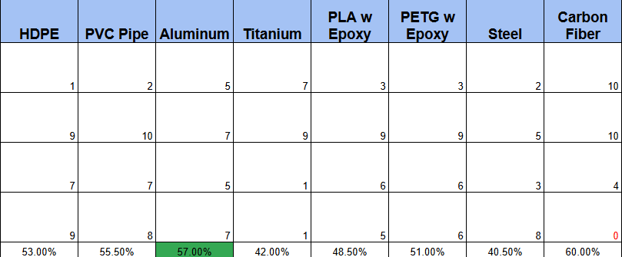
Material Selection

Slide 5
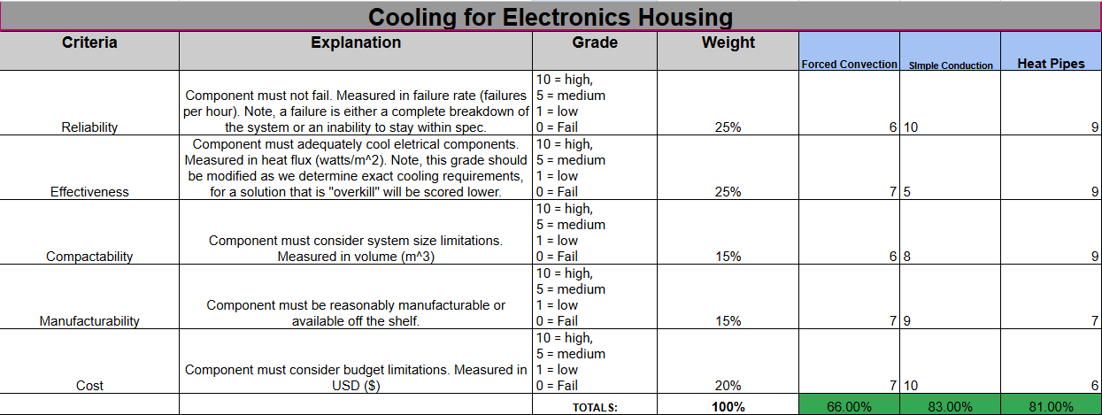
Cooling

Slide 6
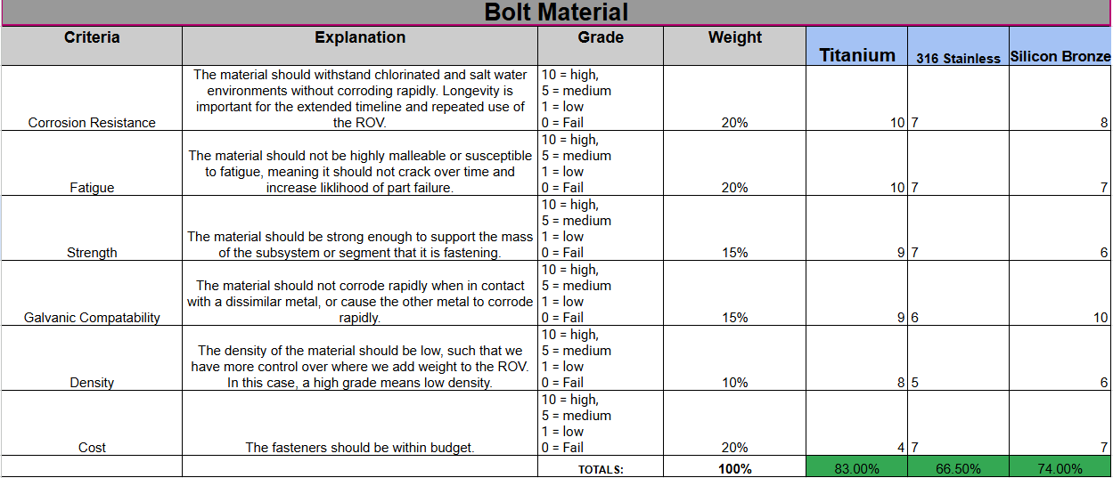
Bolt Material

Slide 7
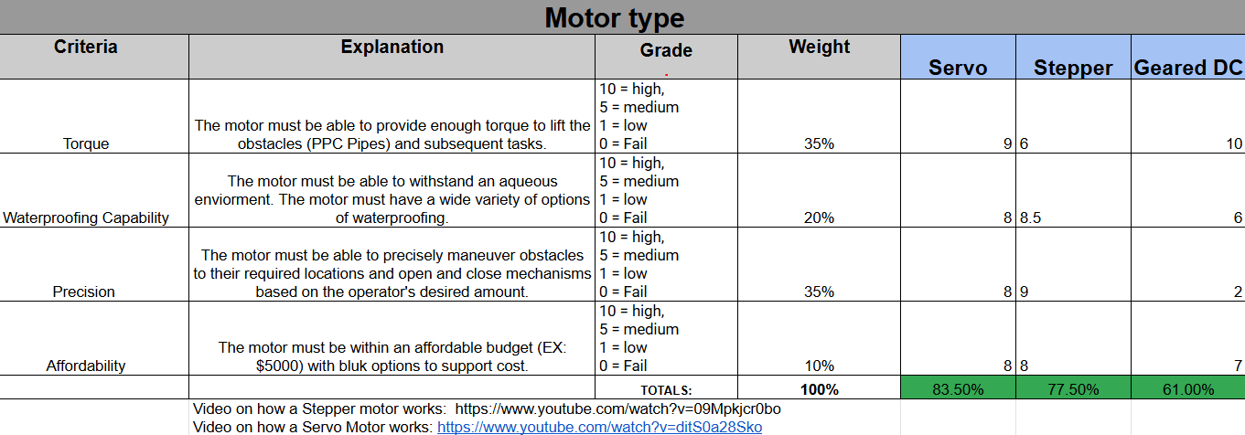
Motor Selection

Slide 8
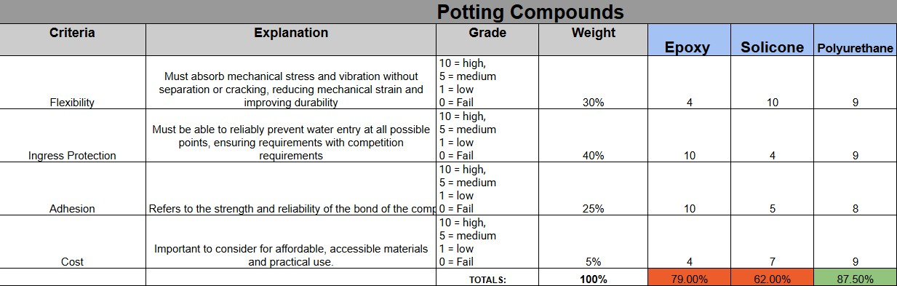
Potting Compounds

Slide 9
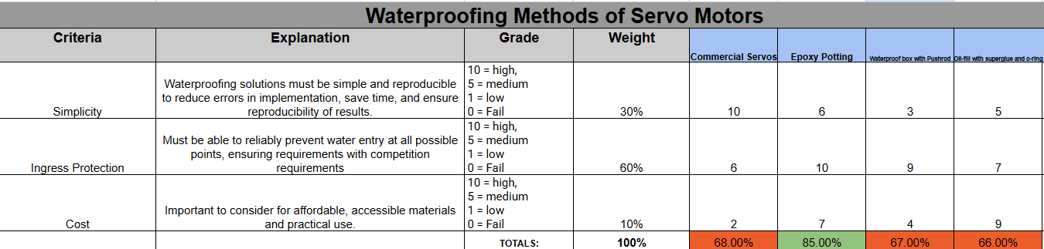
Waterproofing Servo Motors

Slide 10
Guidance Navigation and Control (GNC)

Slide 11
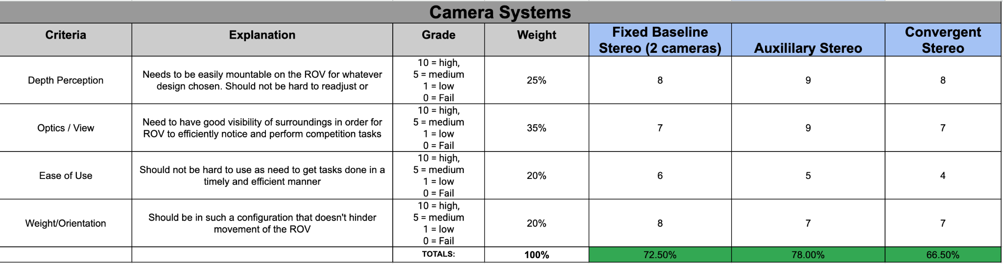
Camera Systems

Slide 12
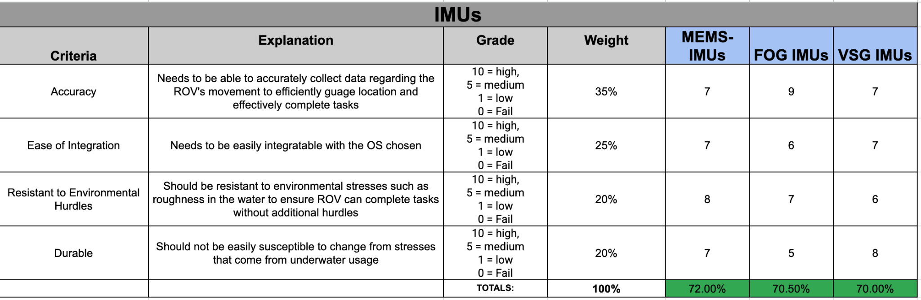
IMUs

Slide 13
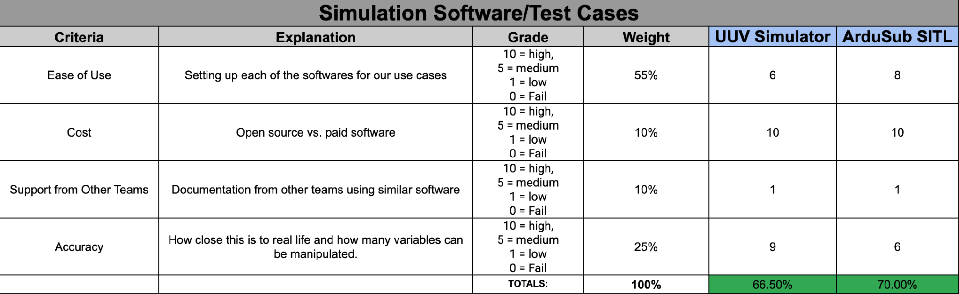
Simulation Software

Slide 14
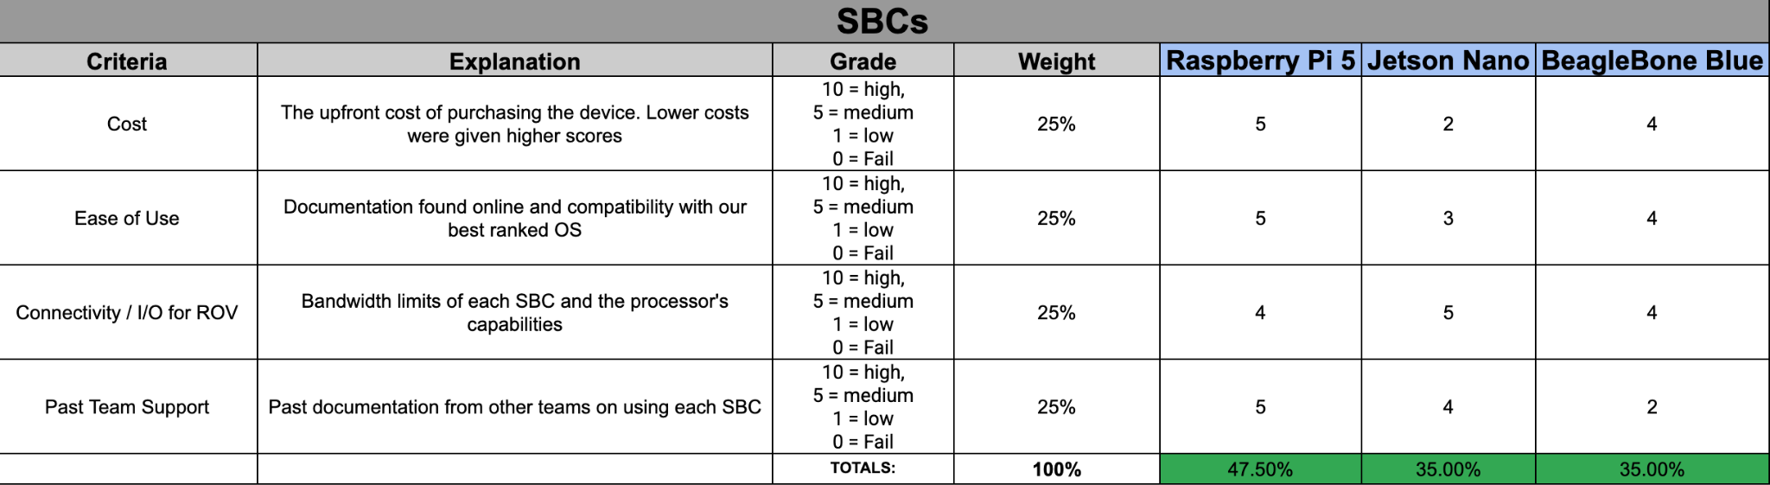
Single Board Computers

Slide 15
Computation and Communications (C&C)

Slide 16
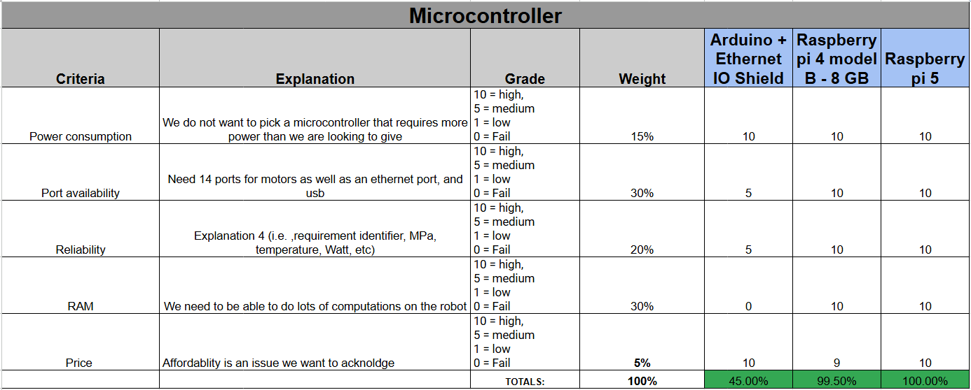
Microcontroller
Notes:
It’s over Vecna, we are the Stranger Things.

Slide 17
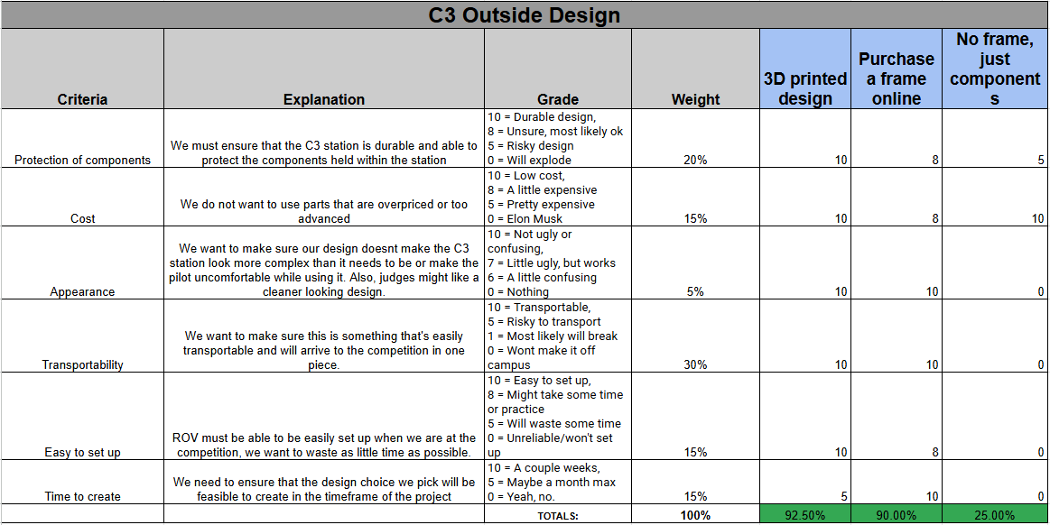
C3 Station Outside Design

Slide 18
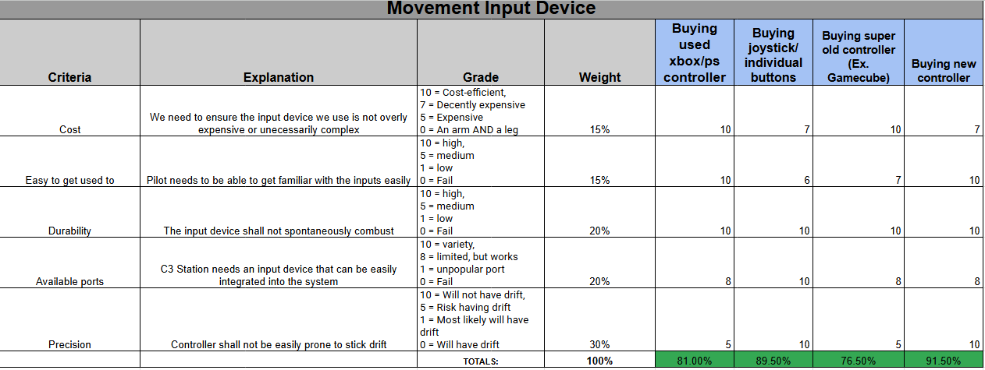
C3 Station Movement Input Device

Slide 19
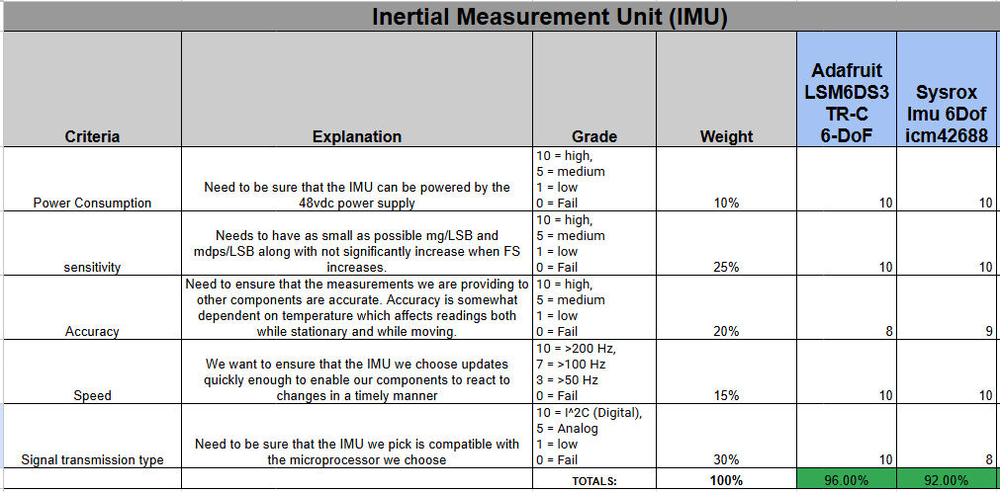
6 DOF IMU

Slide 20
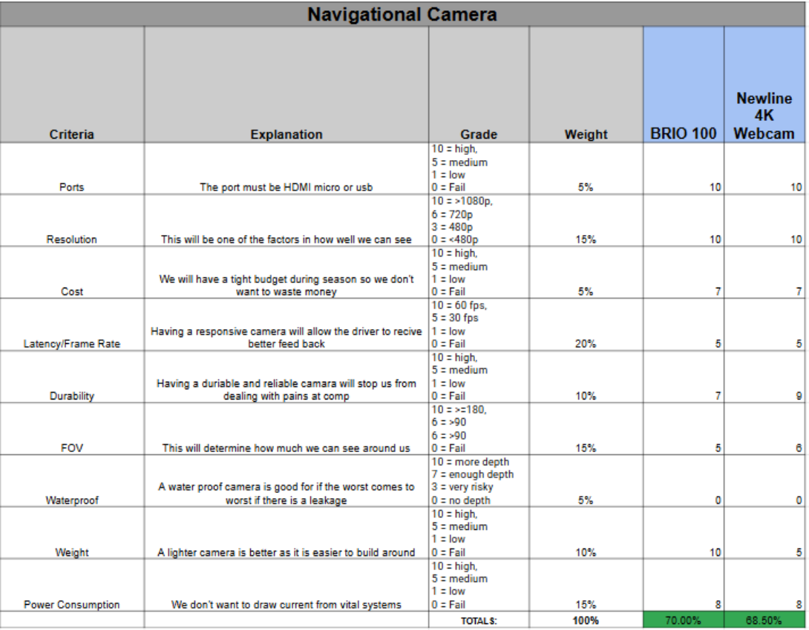
Navigational Camera

Slide 21
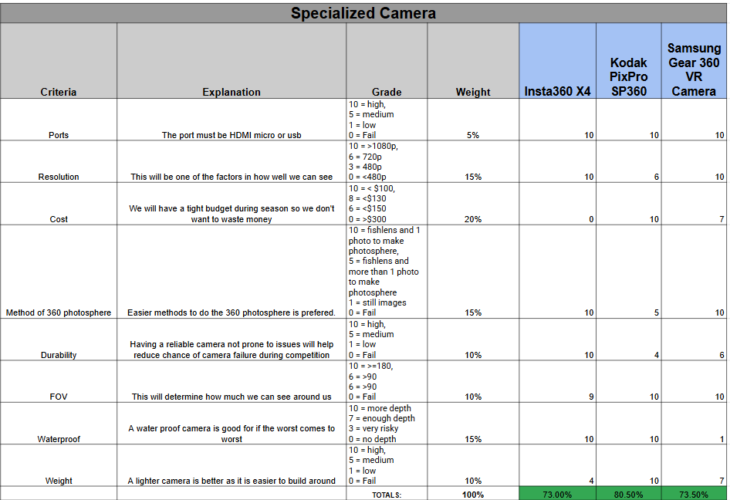
“Specialized” Camera

Slide 22
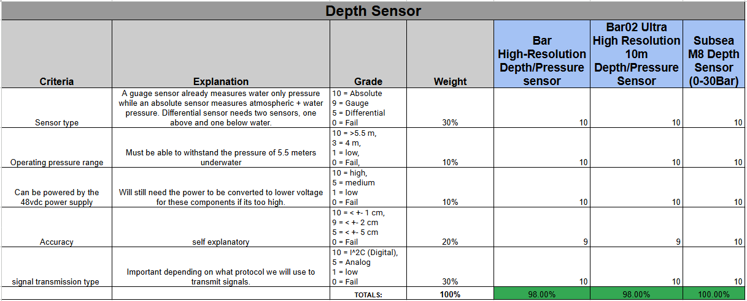
Depth Sensor

Slide 23
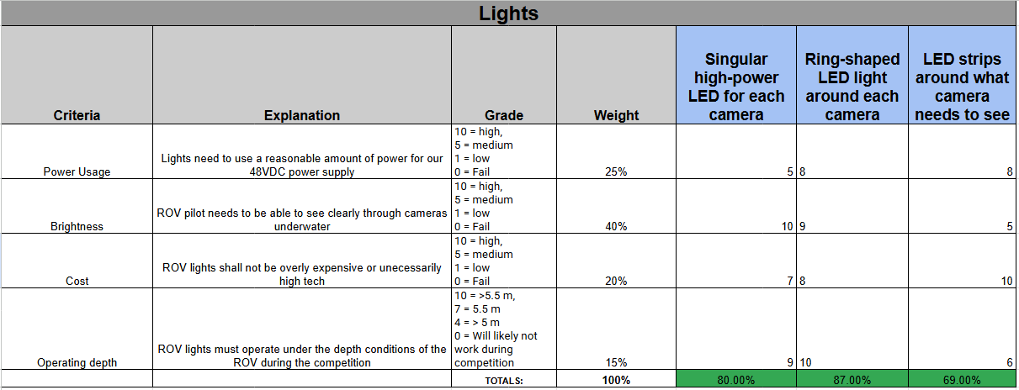
Lights

Slide 24
Fluids & Propulsion (F&P)

Slide 25
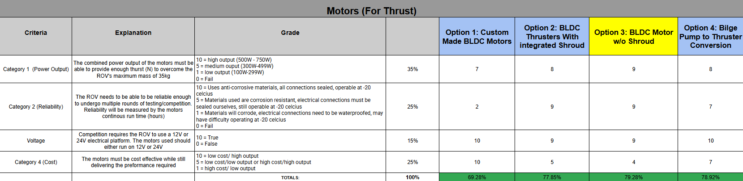
Motors for Propulsion

Slide 26
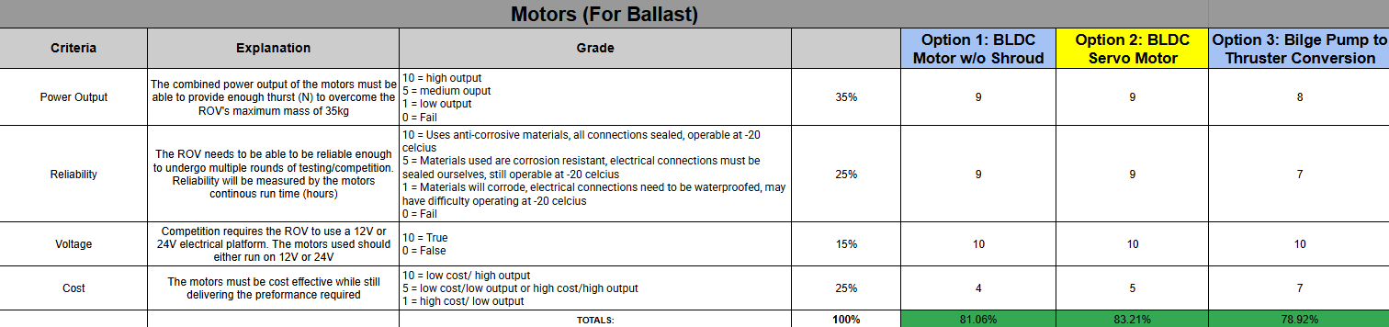
Motors for Ballast

Slide 27
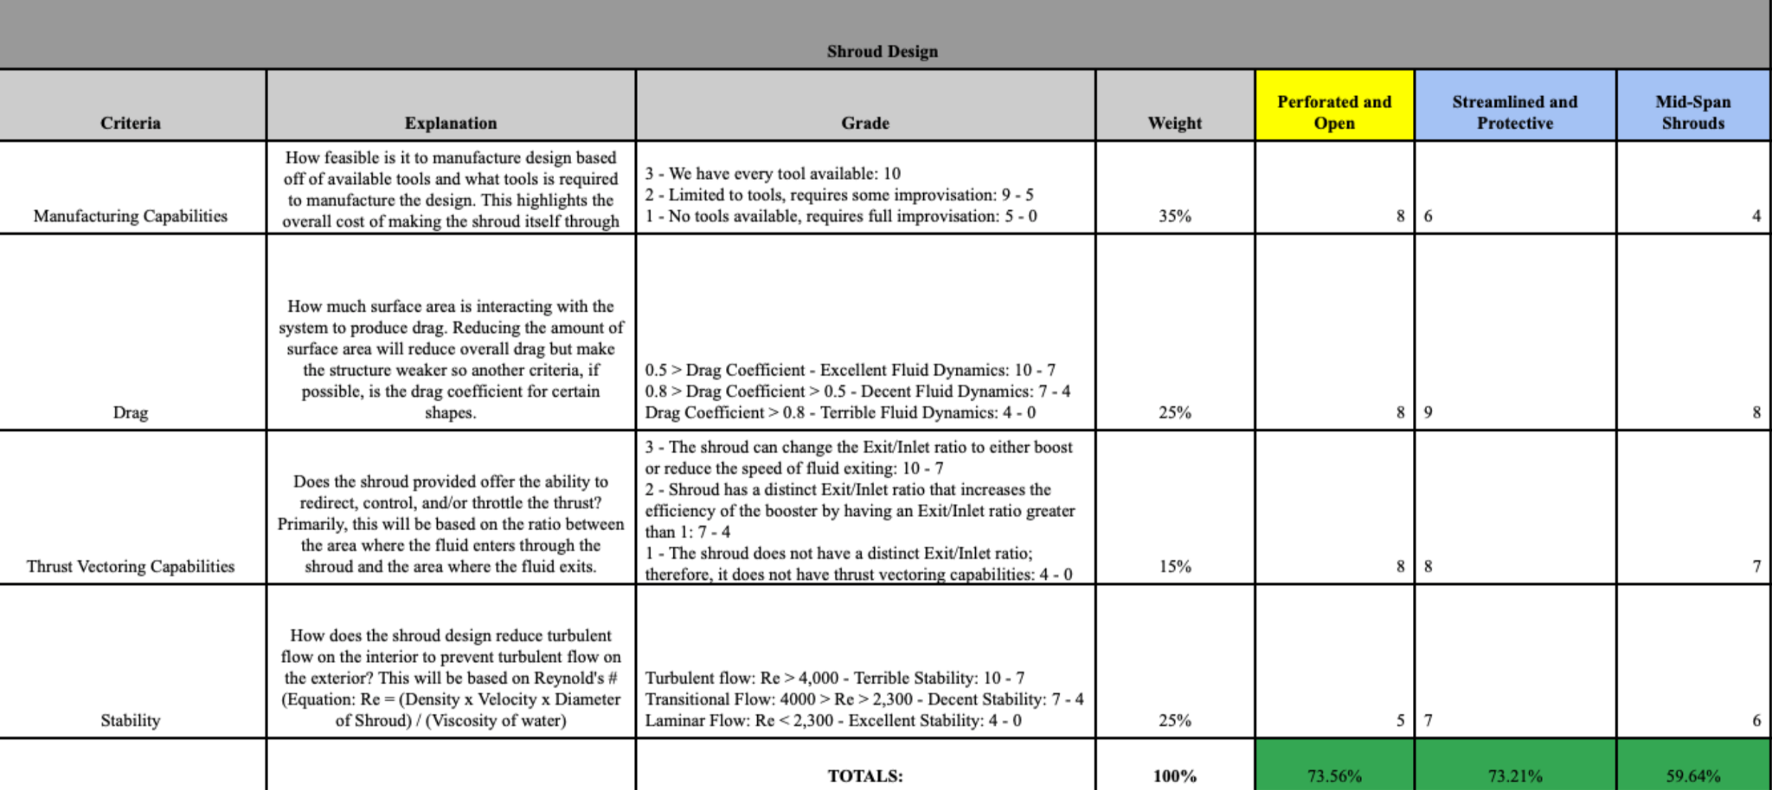
Thruster Guard Shroud Design

Slide 28
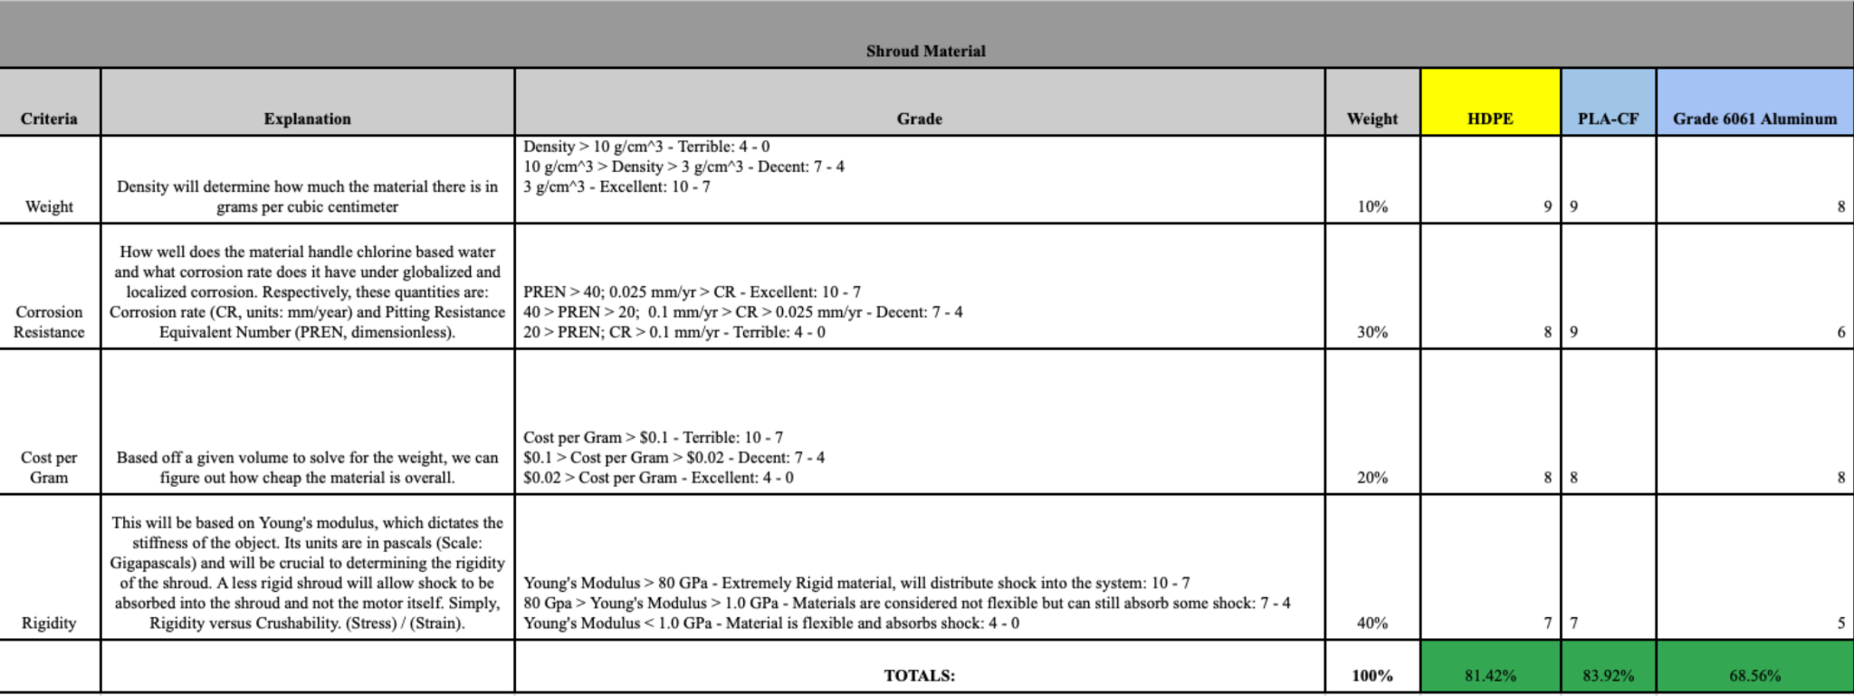
Thruster Guard Shroud Materials

Slide 29
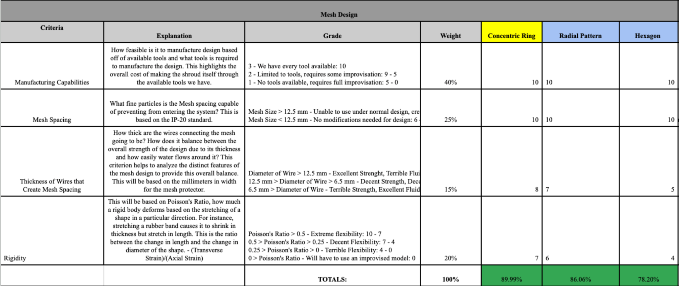
Thruster Guard Mesh Design

Slide 30
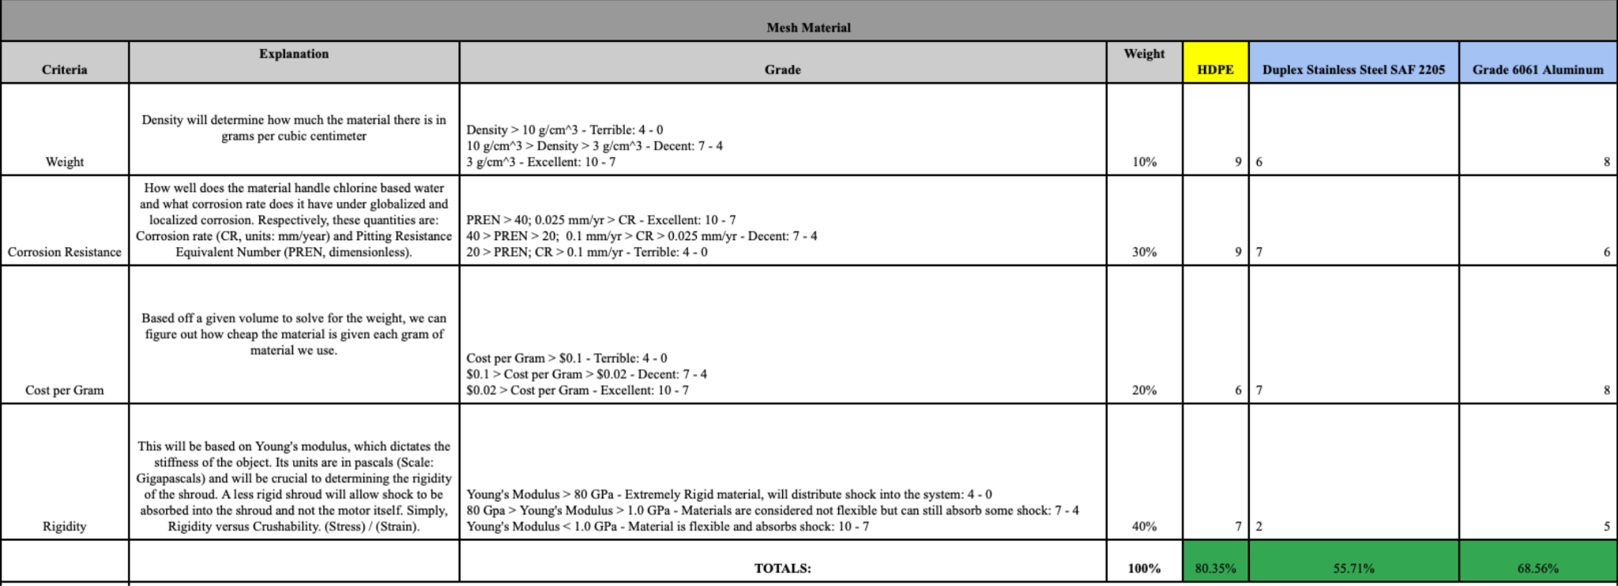
Thruster Guard Mesh Materials

Slide 31
Summary of Thruster Guard Shroud & Mesh
Trade Study Considerations | Chosen Research | Reason For Choosing Research
Thruster Guard Shroud (TGS) Design | Perforated and Open | Provides debris protection for propellers while allowing smooth fluid flow around the TGS.
TGS Material | High Density Polyethylene (HDPE) | HDPE TGS offers an ideal balance of rigidity and flexibility, providing structure while absorbing shock.
Thruster Guard Mesh (TGM) Design | Concentric Ring | Each mesh spacing allows uniform flow while blocking finger-sized debris from the propellers.
TGM Material | High Density Polyethylene (HDPE) | Like the TGS, the TGM should use an HDPE base to balance rigidity and flexibility.

Slide 32
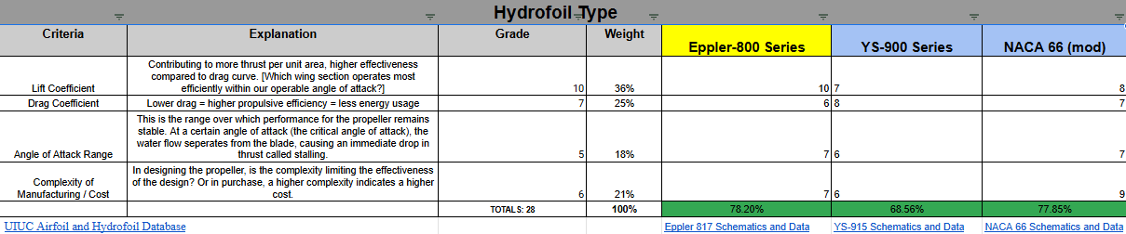
Hydrofoil Type
Notes:
*Re was calculated using the maximum expected velocity and maximum expected length from the leading to the trailing edge of the hydrofoil
*The gain in lift coefficient for the Eppler 800 series outweighed the complexity of manufacturing for the NACA 66 mod
*

Slide 33



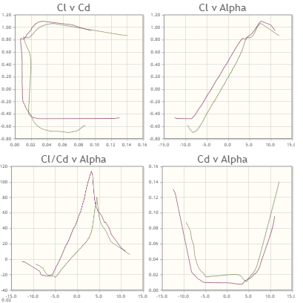
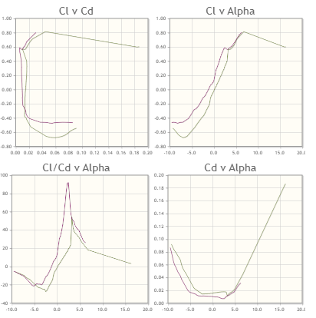
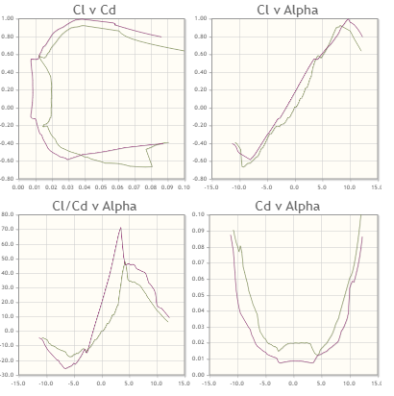
Hydrofoil Schematics
Eppler 817
YS-915
NACA 66
Notes:
It is evident that the Eppler 817 hydrofoil has a significantly higher coefficient of lift curve compared to the other two choices.This lift gain outweighs the complexity of manufacturing for the NACA 66 hydrofoil.
The red curve contributes to a Re of 500,000 while the beige curve contributes to one of 200,000

Slide 34
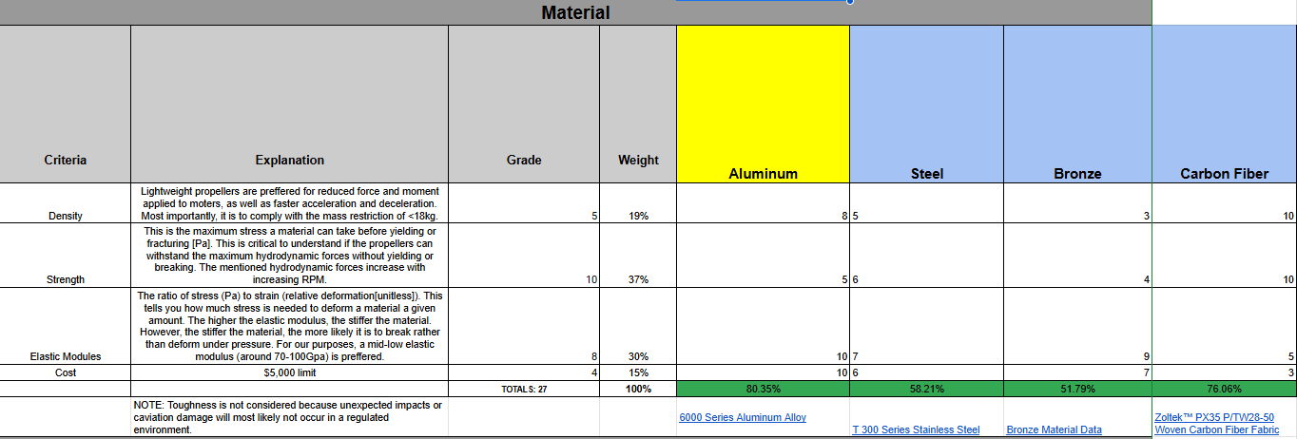
Propeller Material
Notes:
The amount of pressure withstood at the maximum depth of 10 meters does not justify using a propeller created out of carbon fiber. The difficulties of dealing with epoxy reinforcement and manufacturing the carbon fiber in the first place is undesirable.
On the other hand, the aluminum propellers would require us to cast the metal, which might not be an available option to us, or to weld parts together. In that case, we can resort to a fiberglass epoxy propeller.
*NOTE: FEA analysis will be done on upcoming designs in order to further justify material choices.

Slide 35
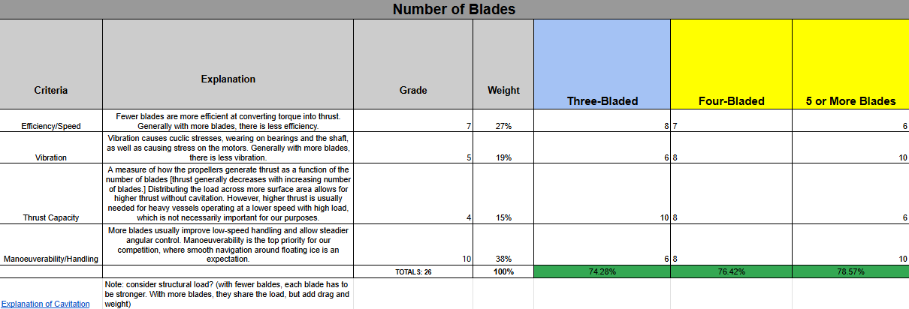
Propeller Blades
Notes:
*NOTE: Number of blades cannot be chosen until the shaft power provided by the motors is available

Slide 36
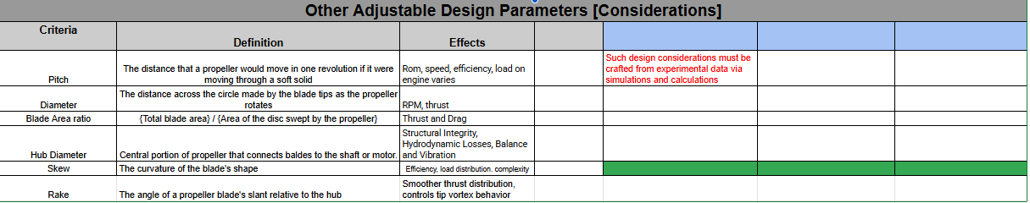
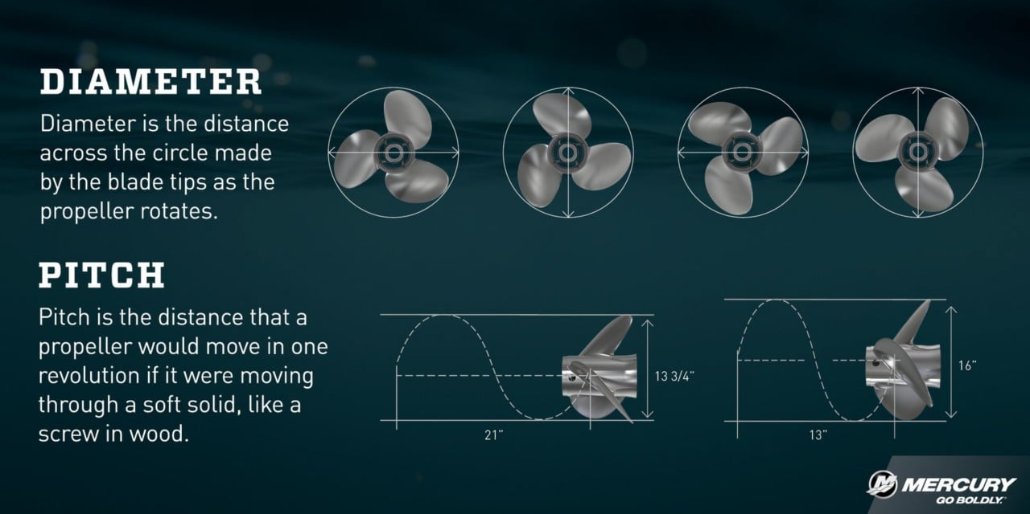
Design Parameters for Consideration

Slide 37
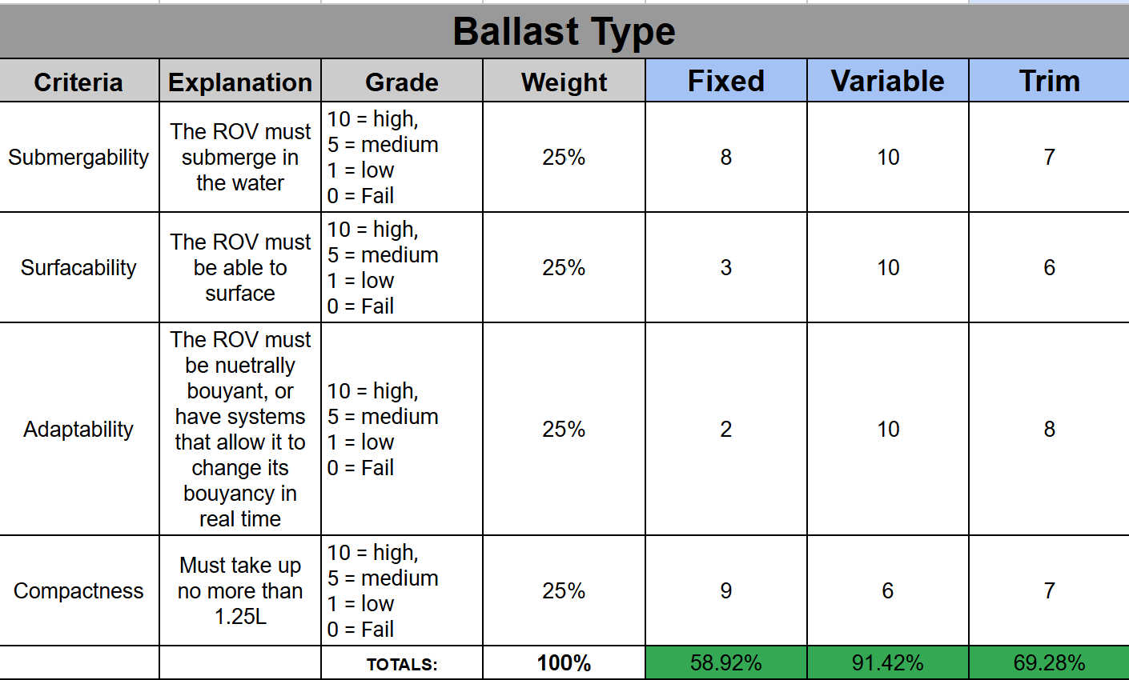
Ballast Type

Slide 38

Ballast Material

Slide 39
Electrical Power Systems (EPS)

Slide 40
Power Supply
Criteria | Explanation | Grade | Weight | 12 VDC | 48 VDC
Tether Cable Size & Weight | Smaller gauge cables can be used with higher voltage, improving maneuverability and reducing drag. | 3 = High 2 = Medium 1 = Low 0 = Fail | 15% | 2 | 3
Power Transmission Efficiency | Lower current at higher voltage reduces I²R losses in the tether cable. This improves efficiency and reduces power loss. |  | 20% | 1 | 3
Thruster Power Delivery | Voltage vs. required thruster input voltage & startup current - especially important if thrusters draw pulsed or high currents |  | 15% | 1 | 3
Voltage Regulation / Stability | Need for DC-DC converters and complexity of power distribution at the ROV end. |  | 10% | 3 | 2
Safety / Standards Compliance | Lower voltages are safer for human handling and reduce underwater electrical hazard risk. |  | 10% | 3 | 2
Component Availability / Cost | Availability of compatible power electronics and end-use subsystems (e.g., sensors, controllers) and their cost. |  | 5% | 3 | 2
Heat Dissipation (Converters) | High current results in higher local power dissipation. Lower heat is easier to manage in a sealed or underwater enclosure. |  | 10% | 1 | 3
Electromagnetic Interference (EMI) | Higher voltages may increase EMI, affecting sensors or communication systems. |  | 5% | 3 | 2
Future Scalability / Growth | Ability to support future upgrades with higher power demand without major redesign. |  | 10% | 1 | 3
 |  |  | 100% | 58.33% | 90.00%

Slide 41
Connectors
Criteria | Explanation | Grade | Weight | SubConn Micro Circular | Blue Robotics WLPs | Cable Glands (Nickel-Plated Brass)
Waterproof Reliability | Most critical criteria; failure is catastrophic for the competition. | 5 = High 3 = Medium 1 = Low 0 = Fail | 22% | 5 | 5 | 4
Mechanical Durability | Must withstand the harsh physical environment (pressure, impacts) to prevent seal failure. |  | 16% | 5 | 4 | 4
Safety & Standards | Ensures electrical safety and adherence to industry standards for reliability. |  | 16% | 5 | 4 | 3
Current/Voltage Capacity | A fundamental design requirement to meet the system's electrical load. |  | 12% | 4 | 4 | 3
Maintenance / Reusability | Lowers long-term operational cost and complexity for repairs and upgrades. |  | 12% | 5 | 4 | 4
Ease of Use | A secondary convenience for us during handling and field operations. |  | 8% | 5 | 3 | 4
Ease of Integration | A one-time effort for the initial build; less impact on long-term operation. |  | 8% | 4 | 5 | 3
Cost & Availability | Lowest priority; performance is valued more than initial cost (this section is the most iffy because idk how much of our budget is going to be used by other things) |  | 6% | 2 | 3 | 5
 |  |  | 100% | 92.4% | 83.2% | 74%

Slide 42
Tether Type/Size
Category | Weight | Criteria | High/Low | Twisted Pair / Electrical Tether |  | Fibre Optic
Cost | 30% | Cost in USD per meter | FALSE | 260 | 30.00% | 279 | 0.00%
Data Transmission Rate/Bandwidth | 50% | In Kbps | TRUE | 100 | 0.00% | 800000000 | 50.00%
Strength/Durability | 20% | Measured in tensile strength in newtons | TRUE | 1520 | 20.00% | 1500 | 19.74%
Totals |  |  |  |  | 50.00% |  | 69.74%

Slide 43
Onboard Architecture
Criteria | Explanation | Grade | Weight | Distributed Local DC-DC Conversion | Dual-Voltage Bus | Single-Bus Centralized DC
Electrical Efficiency | Reduces resistive losses and optimizes power transfer for long tether systems. | 5 = High 3 = Medium 1 = Low 0 = Fail | 18% | 5 | 4 | 3
Safety & Fault Tolerance | Ensures system protection from faults and protects divers and electronics. |  | 18% | 5 | 4 | 3
Modularity / Scalability | Allows expansion, subsystem replacement, or upgrades easily. |  | 14% | 5 | 4 | 2
Maintenance / Serviceability | Simplifies troubleshooting and long-term upkeep. |  | 12% | 3 | 3 | 4
Weight & Space Efficiency | Reduces housing footprint and helps achieve neutral buoyancy. |  | 10% | 3 | 3 | 4
Cost & Complexity | Balances affordability and simplicity of implementation. |  | 10% | 2 | 3 | 5
Ease of Integration | Simplifies wiring, layout, and assembly during manufacturing. |  | 10% | 3 | 4 | 5
Standards / Reliability | Adheres to marine electrical standards and proven reliability. |  | 8% | 5 | 4 | 3
 |  |  | 100% | 81.2% | 73.6% | 69.6%

Slide 44
Wire Color Scheme
Category | Weight | Criteria | High/Low | US IEC 60446 AC/DC Codes |  | ABYC E-11
Simplicity | 20% | Number of required colors/rules | FALSE | 6 | 10.77% | 13 | 0.00%
Ease of Debugging | 60% | Difficult to measure, based on number of useful colors/subsystems | TRUE | 6 | 40.00% | 9 | 60.00%
Standardized Colors | 20% | Use of the coloring scheme, popularity in ROV industry by percent | TRUE | 99 | 20.00% | 90 | 18.18%
Totals |  |  |  |  | 70.77% |  | 78.18%

